Slide 1
The Art Of Developing Applications
"Good programmers write good code; great programmers steal"

Slide 2
What is Engineering ???
Engineering is the application of science and math to solve problems. Engineers figure out how things work and find practical uses for scientific discoveries.

Slide 3
What is a Programming Language ???
A programming language is written in another programming language, by some random guy with some random name.

Slide 4
How do you learn these languages ???
Official Documentation
References
Guides
Examples
Read other peoples code
FOSS (Free Open Source Software)

Slide 5
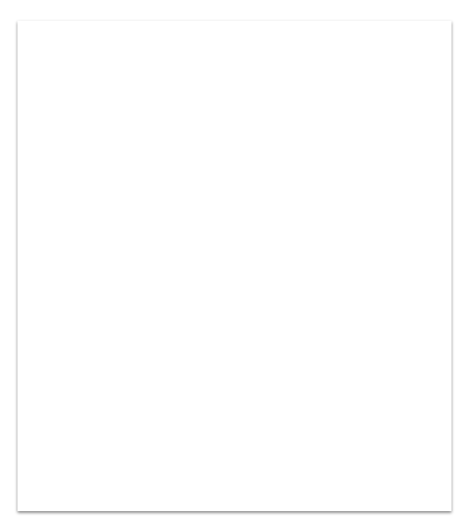
Comparison
C
#include <stdio.h> void main() { printf("Hello, World!\n"); }
Python
print("Hello, World!")

Slide 6
Comparison
C
#include <stdio.h> void main() { int a = 100;
if( a < 20 ) { printf("less\n" ); } else { printf("not less\n" ); } }
Python
a = 100
if a < 20: print "less" else: print "not less"

Slide 7
Comparison
C
#include <stdio.h> void main() {
for(int a=0; a<10; a++){ printf("Hello\n"); }
}
Python
for a in range(0,10): print "Hello"

Slide 8
Comparison
C
#include <stdio.h>
void do_something(int num) { printf(num);
}
void main() { do_something(10);
}
Python
def do_something(num): print num
do_something(10)

Slide 9
Comparison
ruby
x = 100 if x == 200 puts "1" elsif x == 150 puts "2" else puts "3" end
Python
x = 100 if x == 200: print "1" elif x == 150: print "2" else: print "3"

Slide 10
Libraries, Frameworks, Platforms and APIs

Slide 11
Libraries
In programming, a library is a collection of precompiled routines that anyone can use. Libraries are particularly useful for frequently used routines because you do not need to explicitly link all the time.

Slide 12
Libraries
C
#include <stdio.h> #include <math.h> void main () { printf("%f",sqrt(64.0));
}
Python
from playsound import playsound
playsound('audio.mp3')

Slide 13
Frameworks
Frameworks are the foundation on which developers build programs for specific platforms. Frameworks are designed to decrease the number of general issues during the development process by standardizing code that can be applied to a variety of modules or applications.

Slide 14

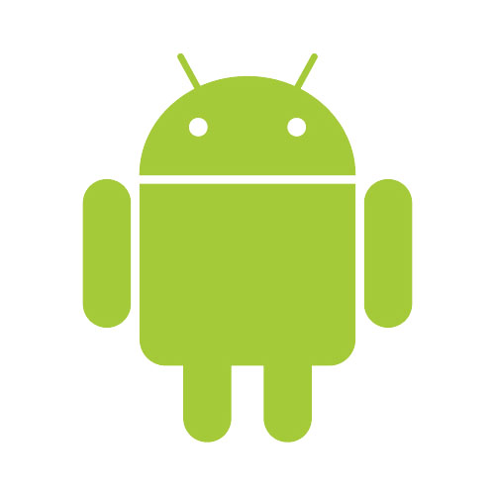




Frameworks

Slide 15
APIs
An application program interface (API) is code that allows two software programs to communicate with each other. The API defines the correct way for a developer to write a program that requests services from an operating system (OS) or other application.

Slide 16
Development Platforms
An application development platform is a type of software that allows a business to rapidly build, test and deploy apps. A business can either build its own mobile application development platform or buy one of the many third-party products available on the market.

Slide 17



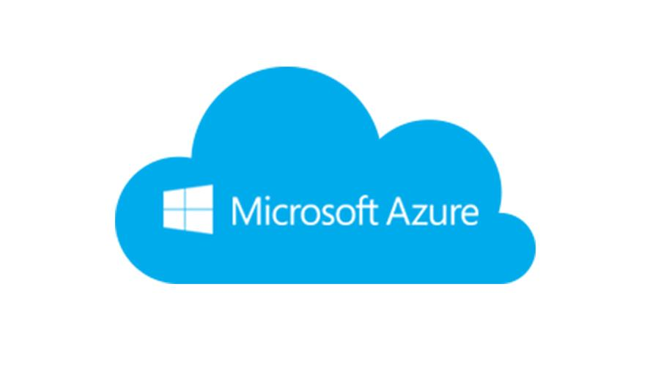

Development Platforms

Slide 18
IDE (Integrated Development Environment)
An integrated development environment (IDE) is a software suite that consolidates basic tools required to write and test software.

Slide 19
Virtual Environment
The main purpose of virtual environments are to create an isolated environment for projects. This means that each project can have its own dependencies, regardless of what dependencies every other project has.

Slide 20
Process
Idea
Frontend
Backend
Coding and Testing
Coding and Testing
Coding and Testing
Coding and Testing
Coding and Testing
Coding and Testing
Integration and Testing
Integration and Testing
Integration and Testing
App

Slide 21
GUI - Graphical User Interface
A graphical user interface (GUI) is an interface through which a user interacts with electronic devices such as computers, hand-held devices and other appliances. This interface uses icons, menus and other visual indicator (graphics) representations to display information and related user controls.

Slide 22
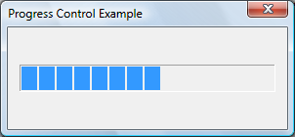
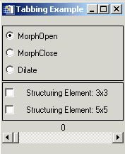
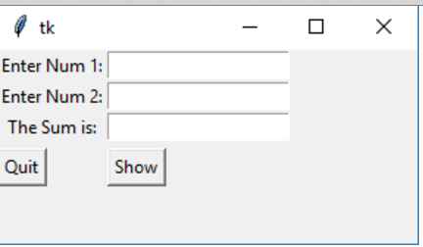
GUI Components
1. button 2. canvas 3. checkbutton 4. entry 5. frame 6. label
7. menu 8. progressbar 9. radiobutton 10. scrollbar

Slide 23
GUI Events
1. click 2. focus 3. button release 4. focus in 5. focus out 6. double click

Slide 24
Musiq Player

Slide 25
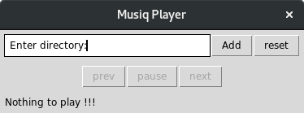

Slide 26
Front end

Slide 27
How do you create the gui elements ???

Slide 28
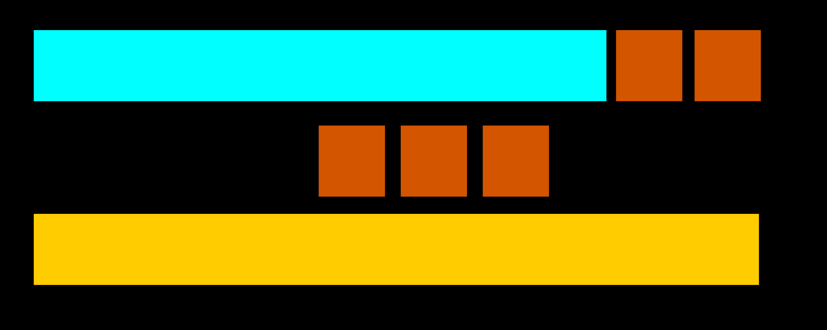

Slide 29
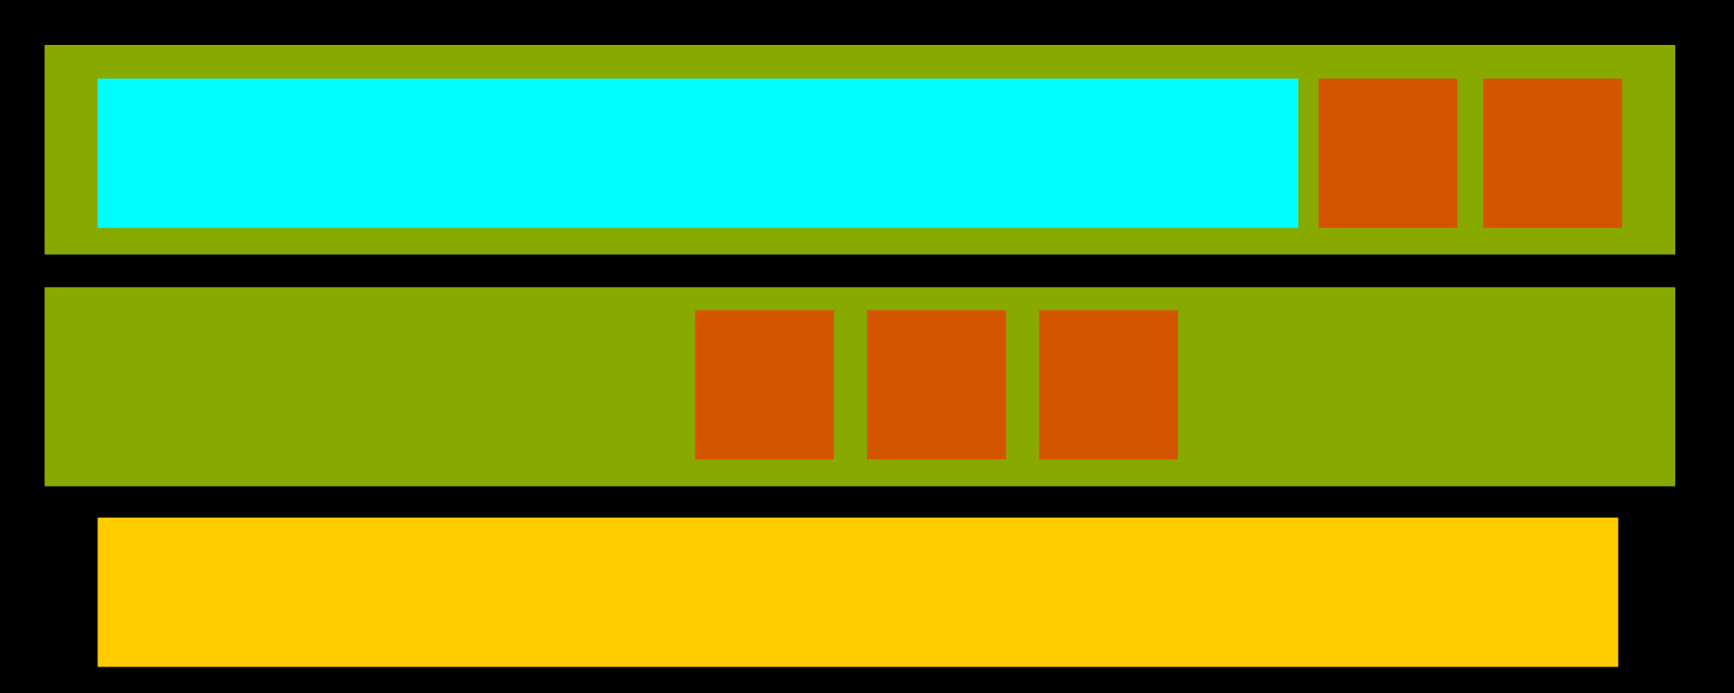

Slide 30
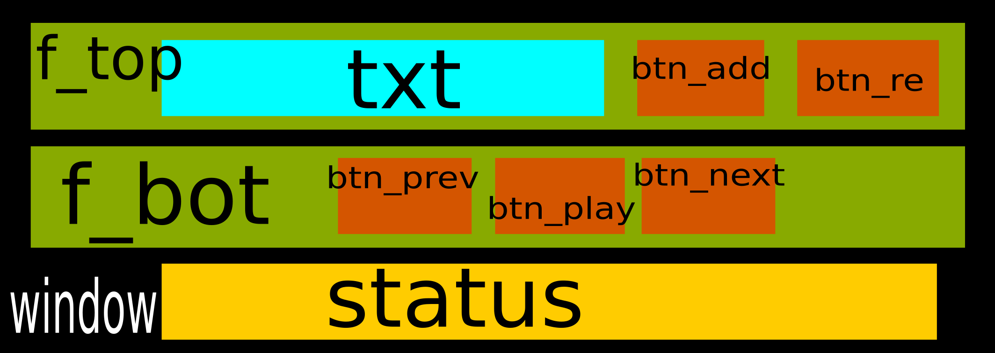
objects - frontend

Slide 31
Back end

Slide 32
How do you get the mp3 files ???
How do you play music ???
How do you manage the actions ???

Slide 33
songList = []
song = 0, 1, 2…..len(songList)
playing = True/False

Slide 34
init_ui()
Clear and add the init text in the txt, status
Reset the variables songList, song, playing
Disable and add init text to the buttons btn_play, btn_next and btn_prev
Reset the player
on_add_click()
# a directory location is given as input in the text and then the button is clicked
Get the directory from the txt
Get all the mp3 files in the directory store the location of each song in songList
If songList is not empty
Disable the txt and btn_add. Enable all the other buttons
Update playing to true
Increment the value of song
Play the index of song in songList
Update status
on_reset_click()
Call the init_ui function

Slide 35
on_next_click()
# If the user has clicked btn_next and is in the last song
If song = len(songList)-1 put song=0
increment song
Play index of song in songList
Update status
on_play_click()
If playing
Pause the player
Change value of playing to false
Disable btn_next, btn_prev
Change the text in btn_play to play
Else
Resume the player
Change value of playing to true
Enable the buttons btn_next, btn_prev
Change the text in btn_play to pause
on_prev_click()
# If the user has clicked btn_prev and is in the starting song
If index of song is 1: put song = len(songList)
Decrement song
Play index of song in songList
Update status

Slide 36
Version Control (git)
Version control is a system that records changes to a file or set of files over time so that you can recall specific versions later.

Slide 37
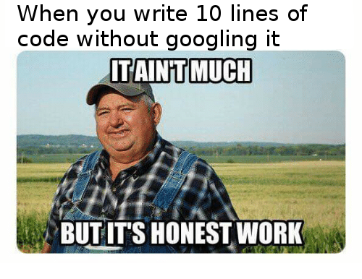

Slide 38

First rule of programming: “If it works don't touch anything, save it somewhere else & do experiment on a copy of it”.
Anonymous

